Slide 1

Capstone Project
Netflix Movies and Tv Shows Clustering
(Ml Unsupervised)
BY
Mohd Faisal Khaleeq
Mohd Kashan

Slide 2
Problem Statement
This dataset consists of tv shows and movies available on Netflix as of 2019. The dataset is collected from Fixable which is a third-party Netflix search engine.
In 2018, they released an interesting report which shows that the number of TV shows on Netflix has nearly tripled since 2010. The streaming service’s number of movies has decreased by more than 2,000 titles since 2010, while its number of TV shows has nearly tripled.
Procedure
Netflix’s recommendation system helps them increase their popularity among service providers as they help increase the number of items sold, offer a diverse selection of items, increase user satisfaction, as well as user loyalty to the company, and they are very helpful in getting a better understanding of what the user wants. Then it’s easier to get the user to make better decisions from a wide variety of movie products. With over 139 million paid subscribers (total viewer pool -300 million) across 190 countries, 15,400 titles across its regional libraries and 112 Emmy Award Nominations in 2018 — Netflix is the world’s leading Internet television network and the most-valued largest streaming service in the world. The amazing digital success story of Netflix is incomplete without the mention of its recommender systems that focus on personalization. There are several methods to create a list of recommendations according to your preferences. You can use (Collaborative-filtering) and(Content-based Filtering) for recommendation.

Slide 3

.
In this project, we are required to do
Exploratory Data Analysis
Understanding what type content is available in different countries
Is Netflix increasingly focused on TV rather than movies in recent years? Clustering similar content by matching text-based features.
Objective
Netflix Recommender recommends Netflix movies and TV shows based on a user's favourite movie or TV show. It uses a Natural Language Processing (NLP) model and a K-Means Clustering model to make these recommendations. These models use information about movies and TV shows such as their plot descriptions and genres to make suggestions.
The motivation behind this project is to develop a deeper understanding of recommender systems and create a model that can perform Clustering on comparable material by matching text-based attributes. Specifically, thinking about how Netflix create algorithms to tailor content based on user interests and behaviour.

Slide 4
Data Description
Attribute Information:
The dataset provided contains 7787 rows and 12 columns.
The following are the columns in the dataset:
Show id: Unique identifier of the record in the dataset
Type: Whether it is a TV show or movie
Title: Title of the show or movie
Director: Director of the TV show or movie
Cast: The cast of the movie or TV show
Country: The list of the country in which a show/ movie is released or watched
Duration: Duration is specified in terms of minutes for movies and in terms of the number of seasons in the case of TV shows
Listed in: This columns species the category/ genre of the content
Description: A short summary about the storyline of the content
Date added: The date on which the content was onboarded on the Netflix platform
Release year: Year of the release of the show/ movie
Rating: The rating informs about the suitability of the content for a specific age group

Slide 5
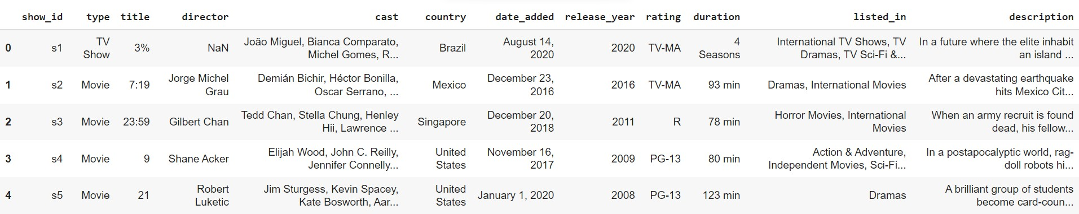
Implementation on missing and duplicate values
1. Handling missing values:
We will need to replace blank countries with the mode (most common) country. It would be better to keep director because it can be fascinating to look at a specific filmmaker's movie. As a result, we substitute the null values with the word 'unknown' for further analysis.
There are very few null entries in the date added fields thus we delete them.
2. Duplicate Values Treatment:
Duplicate values dose not contribute anything to accuracy of results. Our dataset dose not contains any duplicate values.

Slide 6
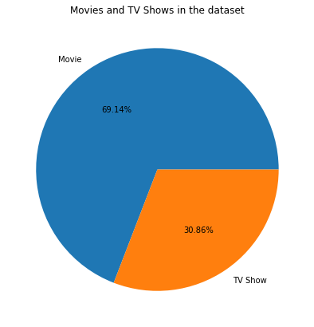
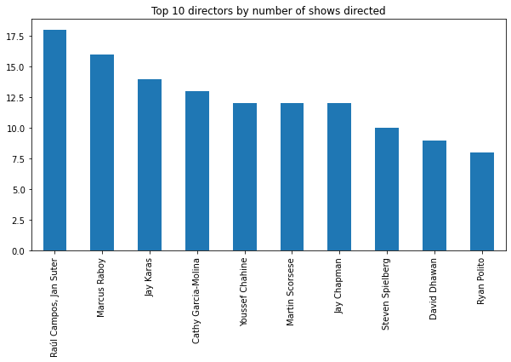

Slide 7
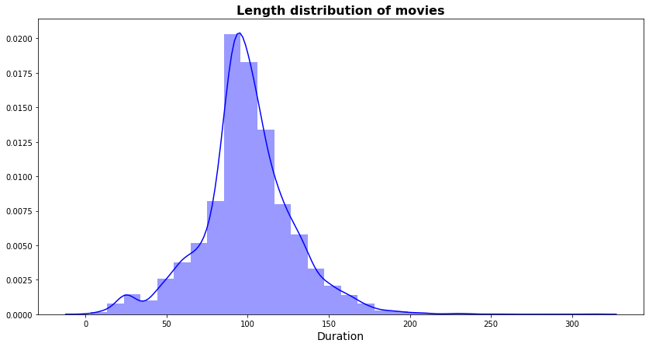

Slide 8
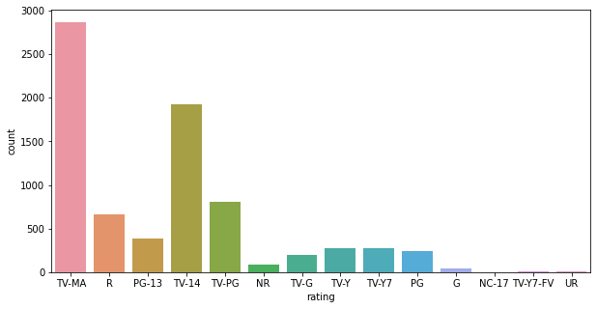

Slide 9
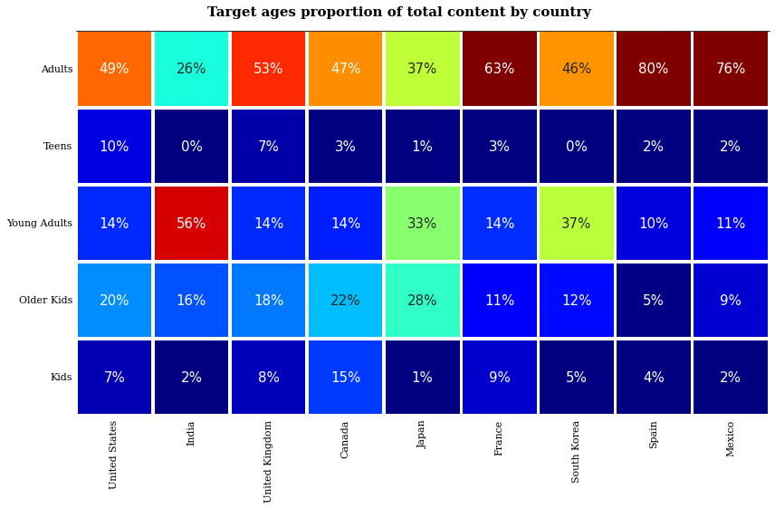

Slide 10
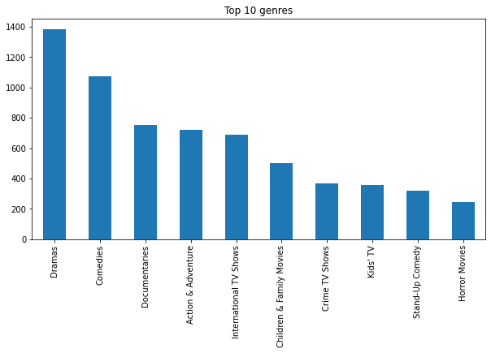
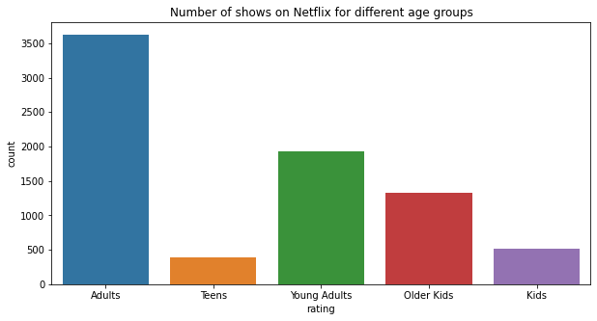

Slide 11
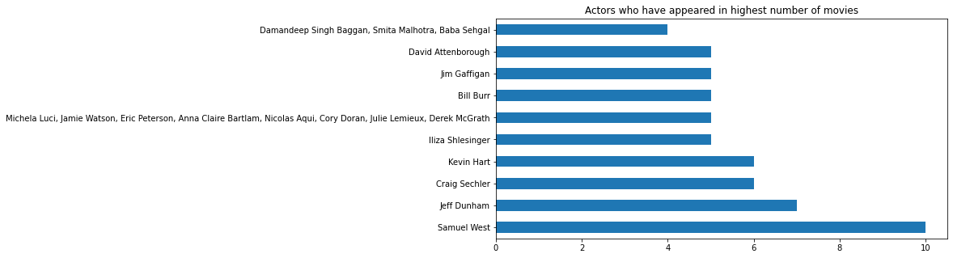

Slide 12
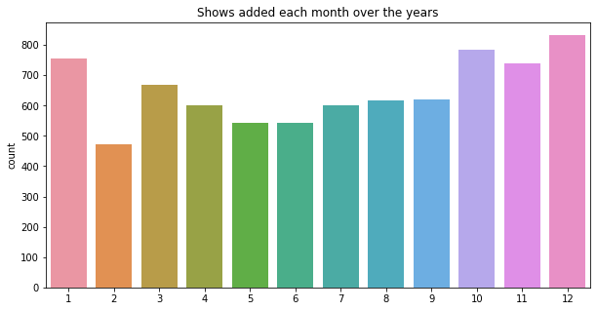

Slide 13
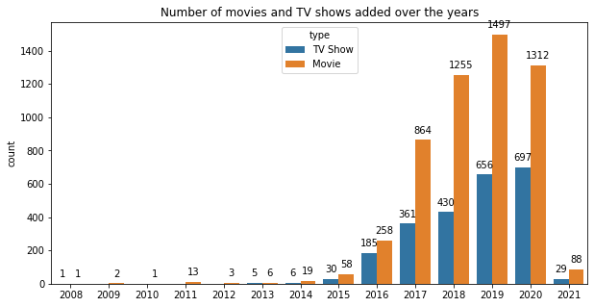

Slide 14
Feature Engineering

Slide 15
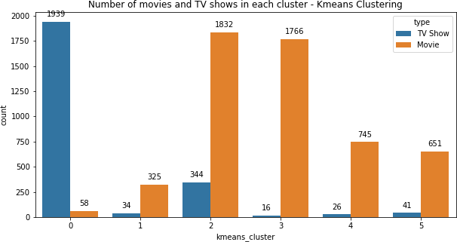
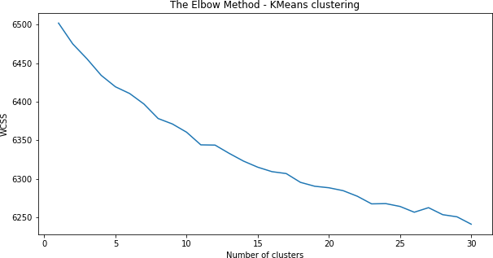
The centroids have stabilized — there is no change in their values because the clustering has been successful.
The defined number of iterations has been achieved.
K-means algorithm is an iterative algorithm that tries to partition the dataset into K pre-defined distinct non overlapping subgroups where each data point belongs to only one group.
1. K-means Clustering
K-means clustering is one of the simplest and popular unsupervised machine learning algorithms. Typically, unsupervised algorithms make inferences from datasets using only input vectors without referring to known, or labelled, outcomes.
K-means algorithm works:
To process the learning data, the K-means algorithm in data mining starts with a first group of randomly selected centroids, which are used as the beginning points for every cluster, and then
performs iterative (repetitive) calculations to optimize the positions of the centroids. It halts creating and optimizing clusters when either:
Elbow Curve:

Slide 16
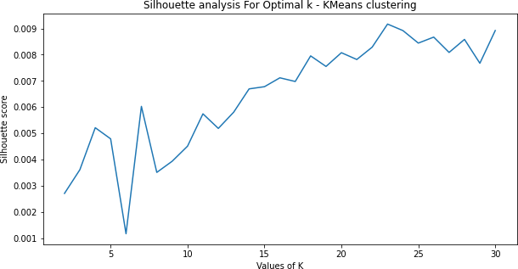
Elbow Curve is one of the most popular methods to determine this optimal value of k.
The elbow curve uses the sum of squared distance (SSE) to choose an ideal value of k based on the distance between the data points and their assigned clusters.
Silhouette’s Coefficient-
If the ground truth labels are not known, the evaluation must be performed utilizing the model itself. The Silhouette Coefficient is an example of such an evaluation, where a more increased Silhouette Coefficient score correlates to a model with better-defined clusters. The Silhouette Coefficient is determined for each sample and comprised of two scores
Mean distance between the observation and all other data points in the same cluster. This distance can also be called a mean intra-cluster distance. The mean distance is denoted by a.Mean distance between the observation and all other data points of the next nearest cluster. This distance can also be called a mean nearest-cluster distance. The mean distance is denoted
by b. The Silhouette Coefficient s for a single sample is then given as:𝑠 =
𝑏−𝑎
𝑚𝑎𝑥(𝑎,𝑏)

Slide 17
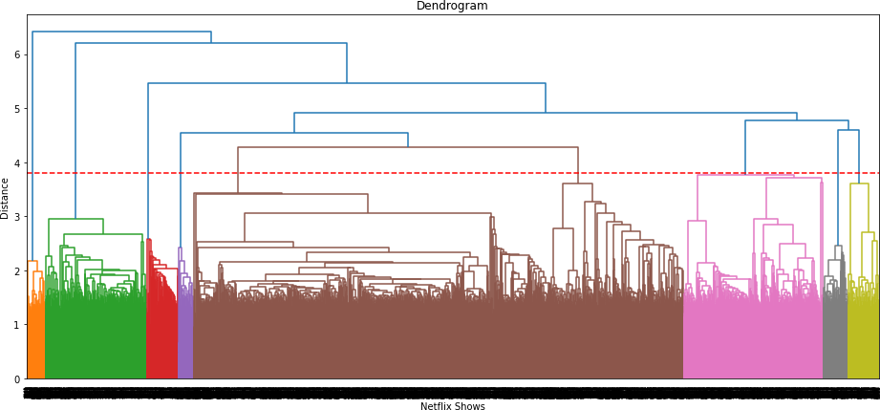
2.Hierarchical-clustering
Hierarchical Clustering, also known as hierarchical cluster analysis, is an algorithm that groups similar objects into groups called clusters. The endpoint is a set of clusters, where each cluster is distinct from each other cluster, and the objects within each cluster are broadly similar to each other.
Hierarchical Clustering can be performed with either a distance matrix or raw data. When raw data is provided, the software will automatically compute a distance matrix in the background.
The agglomerative clustering is the most common type of hierarchical clustering used to group objects in clusters based on their similarity. ... Next, pairs of clusters are successively merged until all clusters have been merged into one big cluster containing all objects.

Slide 18
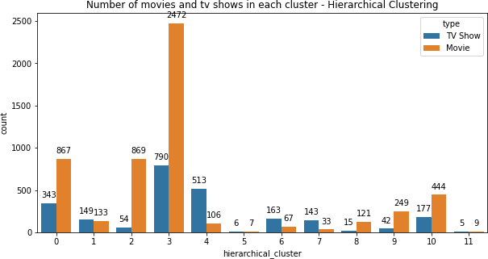
Conclusion: -
In this project, we worked on a text clustering problem wherein we had to classify/group the Netflix shows into certain clusters such that the shows within a cluster are similar to each other and the shows in different clusters are dissimilar to each other.
The dataset contained about 7787 records, and 12 attributes. We began by dealing with the dataset's missing values and doing exploratory data analysis (EDA).
It was found that Netflix hosts more movies than TV shows on its platform, and the total number of shows added on Netflix is growing exponentially. Also, majority of the shows were produced in the United States, and the majority of the shows on Netflix were created for adults and young adults age group.
Once obtained the required insights from the EDA, we start with Pre-processing the text data by removing the punctuation, and, stop words. This filtered data is passed through TF - IDF Vectorizer since we are conducting a text-based clustering and the model needs the data to be vectorized in order to predict the desired results.
It was decided to cluster the data based on the attributes: director, cast, country, genre, and description. The values in these attributes were tokenized, pre-processed, and then vectorized using TFIDF vectorizer.

Slide 19
Through TFIDF Vectorization, we created a total of 20000 attributes. We used Principal Component Analysis (PCA) to handle the curse of dimensionality. 4000 components were able to capture more than 80% of variance, and hence, the number of
components were restricted to 4000. We first built clusters using the k-means clustering algorithm, and the optimal number of clusters came out to be 6. This was obtained through the elbow method and Silhouette score analysis.
Then clusters were built using the Agglomerative clustering algorithm, and the optimal number of clusters came out to be 12. This was obtained after visualizing the dendrogram.
A content-based recommender system was built using the similarity matrix obtained after using cosine similarity. This recommender system will make 10 recommendations to the user based on the type of show they watched.

